Slide 1
EVIDENCE-BASED PREVENTION: POLICY AND PRACTICE
Mrs. Rene Adams(MA SW)
Program Manager: Substance Abuse Prevention, Drug Control and Rehabilitation
Ministry of Health and Social Services
Harvey Street
WINDHOEK
NAMIBIA
Notes:
This unit should take approximately 1 hour and 15 minutes.
Step 1: Introduction (Slides 1 – 3) – 30 minutes
Step 2: Course Materials (Slide 4) 2 minutes
Step 3: Learning Assessment (Slide 5) - 5 minutes
Step 4: Ground Rules (Slide 6) – 5 minutes
Step 5: Parking Lot (Slide 7) 5 minutes
Step 6: Pre-Assessment (Slide 8) – 30 minutes
Greet participants and welcome them to the course.
Review housekeeping issues such as the location of the bathrooms, meal times and location and start and end times.
Ensure that all participants have signed in and have provided registration information.
Distribute name tags, participant manuals and other materials.

Slide 2
Outline
Introduction
Objectives
Key role players
Model of Intervention
Model of Intervention and the Role of the Social Workers

Slide 3
Introduction
Most prevention programs focused on approaches designed to affect individuals, peers, families and communities
For the purpose of this presentation I will focus on the approach to affect the larger communities by implementing a comprehensive, multi-sectoral approach with stakeholders from:
Various sectors of society, including government, community based organizations, non governmental organizations, private sector, development partners and international agencies who play different roles in reducing alcohol relating harm in the communities

Slide 4
Objectives for CORD PROGRAMME
To reduce substance abuse through structural interventions;
To build alcohol use prevention skills;
To evaluate and expand behavioral interventions;
To develop coalitions;
To institutionalize substance use risk reduction media

Slide 5
Key role players in this model
Social Workers
Police officers
Regional and Local authorities
Teachers
Family members
CORD Committees
Faith based organizations leaders
International Organizations (e.g. WHO, CDC, all UN agencies)

Slide 6
Model of intervention
The CORD, is a preventative program, which started off to reduce alcohol related harm, and substance use was included and;
The CORD served as a forum for health, social, business, civic and law enforcement leaders, as well as representation from treatment center's to coordinate their response to address substance abuse related harm.
The CORD strengthen collaboration among communites, police officers and social workers, magistrate office and political leaders

Slide 7
Model of intervention
The key intervention of CORD are:
Prevention
Legislation enforcement
Expanding treatment options

Slide 8
Model of intervention
  CORD focus on establishing CORD committees to identify key activities that all regions should include as part of their planning
To have community meetings, school site, house to house visits and other activities
The CORD committees increase awareness raising and mobilize communities on the effects of drug abuse, dissemination and distribution of information on substance use
Alcohol toolkit and picture codes are used as prevention tools

Slide 9

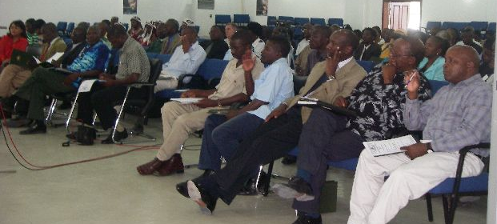
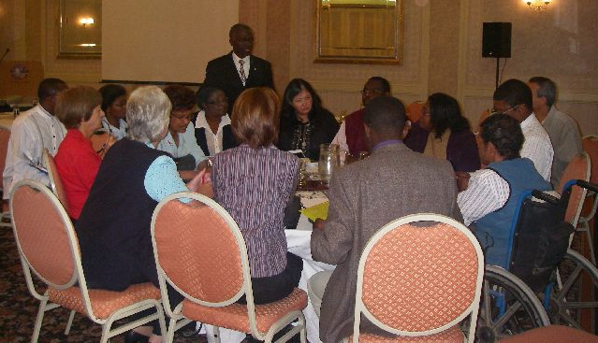
Established CORD committees
Erongo Regional
CORD Committee
Which is chaired by Dr. P.S. K. Tshiteta, MOHSS, Erongo Region
Kavango Regional
CORD Commiittee
Which is chaired by Ms. E. Muremi, Director of MOHSS, Kavango Region.

Slide 10
Model of intervention
The CORD committee identify shebeens, bars that sell alcohol but are not licensed or do not keep to trading hours
the committee also identifies high-risk or problem environments and inform the police accordingly
The committees oppose new applications for licensing to sell alcohol at shebeens or bars which are near schools or religious places by attending the Magistrate Courts
Police are mapping these areas which are prone for crime

Slide 11

Under aged Drinking Campaign
Notes:
School campaigns, media campaings
11

Slide 12
Model of intervention
The committees establish support groups which meet regularly;
  To support each other, building consensus and pursue common goals
  Make the programme sustainable through skills building, along with education and awareness sessions conducted
members are trained, amongst others on brick and candle making to create self-employment opportunities
The program promotes voluntarism and participation of the community at large to
Make services accessible to the community.

Slide 13
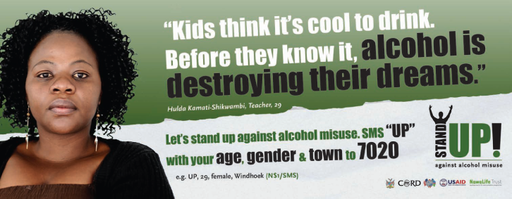
Stand Up! Campaign Print Ads

Slide 14
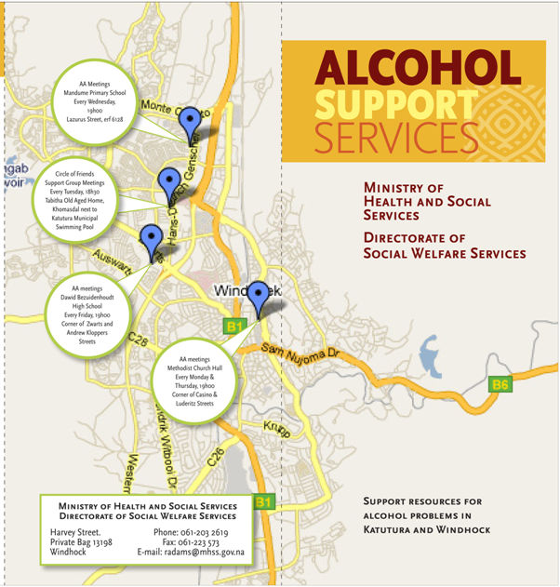
Alcohol Support Service Brochures
Notes:
Participants to draw a map of their area and indicate where one can get alcohol related support services.

Slide 15
Model of intervention and role of social workers
The support groups meet with social workers to discuss burning issues on drug abuse in the community and find solutions on how to address these problems
The social workers train and provide technical assistance to the committee members to provide education and awareness raising and
The members identify and refer clients to social workers.

Slide 16
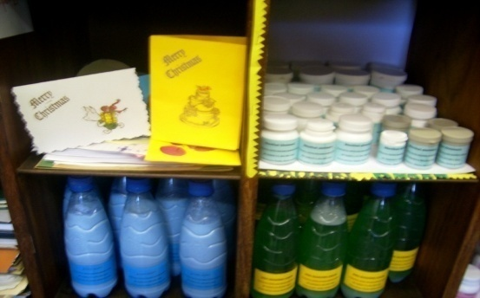
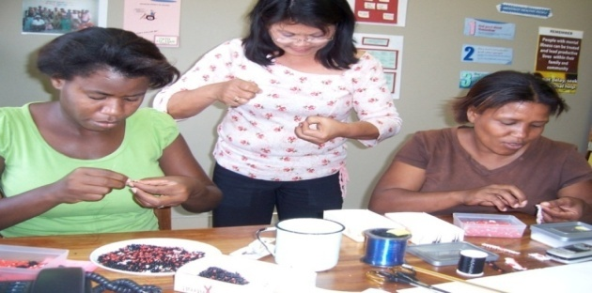

Slide 17
Model of interventions and role of social worker
Social Workers guide CORD Committees on how to address issues such as illegal selling of alcohol at pay points of older persons and other recipients of government grants
Social Workers also guide committee members to oppose new applications for alcohol licenses in the regional magistrate courts which are near schools or religious places

Slide 18
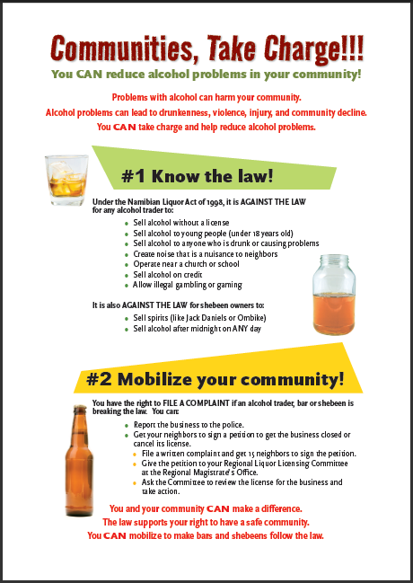
Alcohol Toolkit Posters (3)

Slide 19
Model of interventions and treatment options
Treatment is the third leg of intervention and committees and health professionals are trained to screen and refer individuals to self-help support groups (AA groups) and clients to outpatient and in-patient treatment centres
Social workers facilitate the process for the client to access a rehabilitation centre in the country or even abroad
Social workers also conduct family therapy in the process of preparing the client for rehabilitation
And assist the client and family with reintegration, follow-up and support after treatment in an outpatient or inpatient program

Slide 20
CONCLUSION
This model is a best practice and has proven to be successful in Namibia because community members are trained to identify individuals and at an early stage and refer t social workers for help.
CORD committees are also working on grass roots level and the community accept them because they are part of the community.
The committee serve as a helping hand for social workers.
Support groups are accessible and available to the members of the community who wants to stop using alcohol and drugs
The CORD promotes strong community participating and partnership while contributing to enhance the self-reliance of its community members in entrepreneurship and income generation

Slide 21
THANK YOU !!!!!!

